Slide 1
Law Is…

Slide 2

The Law is the Truth! – A Few Good Men

Slide 3
Two-Part Definition
Rules and regulations made and enforced by some kind of government
Laws are provided to regulate society’s conduct

Slide 4
Definition (cont’d)
Present-day governments cannot function if laws are not enforced or respected
1. this is known as the “rule of law” (ALL society members must follow laws)
2. No one should be above the law (Is this reality???)
One of the reasons why the legal system is symbolized by a balanced scale is because in theory everyone is seen as “equal” before the law

Slide 5

Goals of a Legal System
Protect the rights of citizens (freedoms they enjoy)
Promote equality in society
Resolve conflicts between citizens when they cannot be resolved themselves
Promote order and stability in society

Slide 6

Values of Society
Laws are created to reflect the values of a society (what a society feels is important)
1. moral – laws that deal with “right and wrong conduct
2. economic – laws that deal with money

Slide 7


Values (cont’d)
3. Political – laws that deal with the relationship between government and individual
4. Social – laws that society deems to be “important at the moment” (i.e. smoking bans)

Slide 8
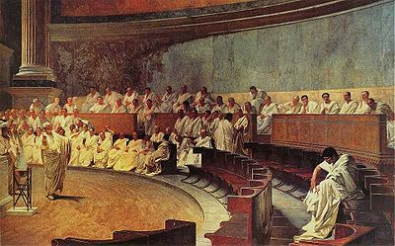
How Did Our Legal System Develop?
We are based on a democratic system of government
1. created by the Romans
2. citizens vote for representatives in government who in turn pass laws on behalf of their constituents
The Roman Senate represented both classes in Roman society: upper (patrician) and common (plebian)

